Slide 1
The use of mixture distributions in a Bayesian linear mixed effects model
Anirudh TOMER
Promoter: Professor Emmanuel LESAFFRE

Slide 2

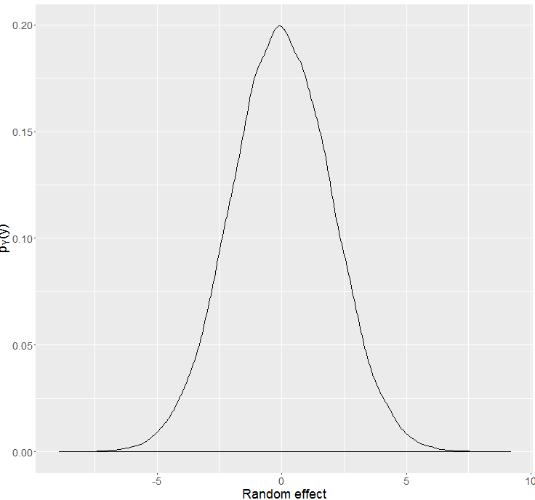
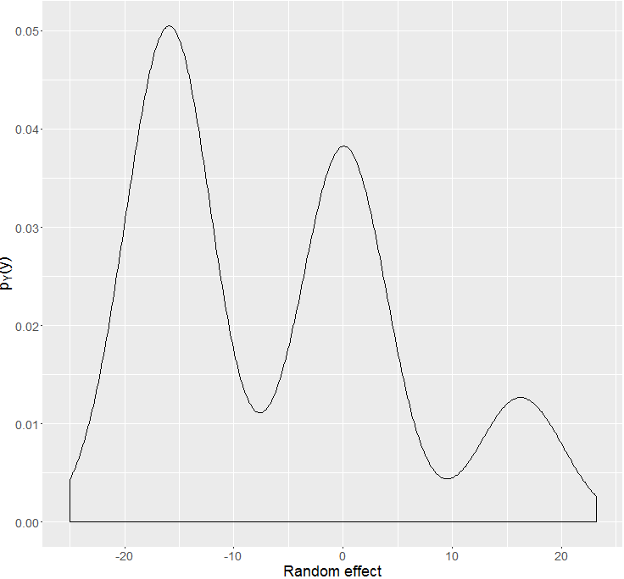






Bayesian heterogeneity model
Gender: Male, Age: 37
Gender: Female, Age: 23
Gender: Male, Age: 41
Gender: Female, Age: 59
Gender: Female, Age: 35
. .
.
. .
.
Gender: Male, Age: 19

Slide 3
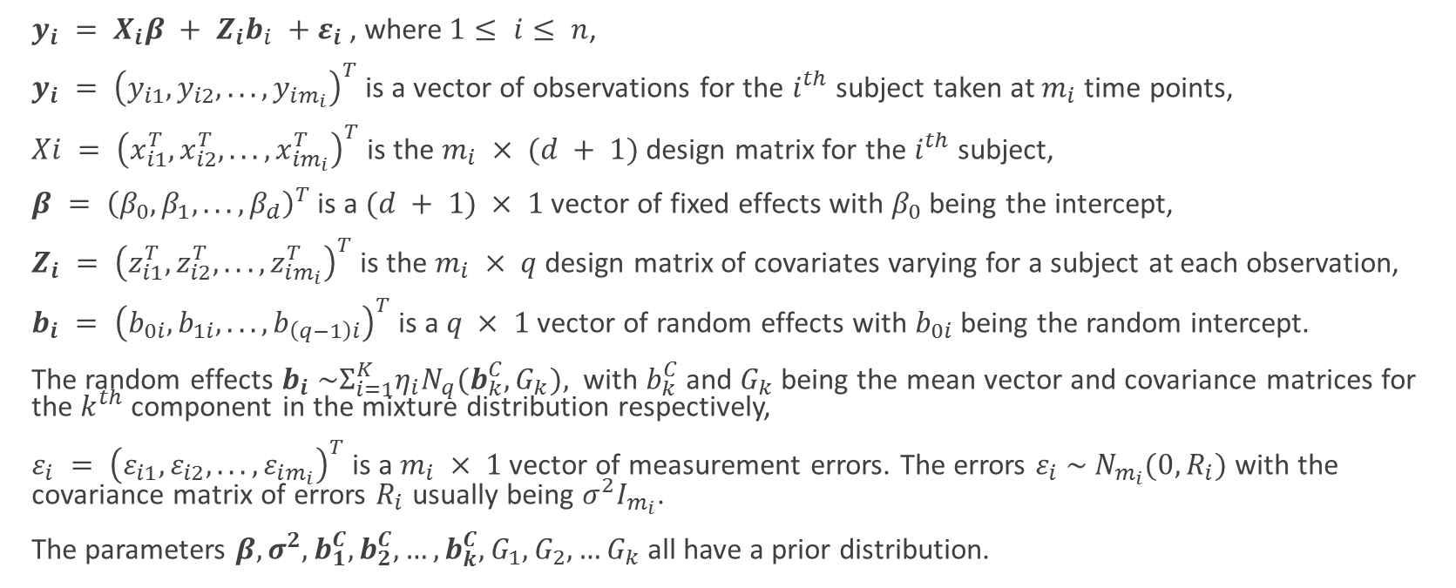
Mathematical notation
$y_{i} = X_{i}β + Z_{i}b_{i} +ε_{i}$, where$1≤ i≤ n$,
$y_{i} = {\left(y_{i1}, y_{i2}, . . . , y_{im_{i}}\right)}^{T}$is a vector of observations for the $i^{th}$ subject taken at $m_{i}$ time points,
$Xi = {\left(x_{i1}^{T}, x_{i2}^{T}, . . . , x_{im_{i}}^{T}\right)}^{T}$is the $m_{i} × (d + 1)$ design matrix for the $i^{th}$ subject,
$β = {\left(β_{0}, β_{1}, . . . , β_{d}\right)}^{T}$ is a $(d + 1) × 1$ vector of fixed effects with $β_{0}$ being the intercept,
$Z_{i} = {\left(z_{i1}^{T}, z_{i2}^{T}, . . . , z_{im_{i}}^{T}\right)}^{T}$ is the $m_{i} × q$ design matrix of covariates varying for a subject at each observation,
$b_{i} = {\left(b_{0i}, b_{1i}, . . . , b_{\left(q−1\right)i}\right)}^{T}$is a $q × 1$ vector of random effects with $b_{0i}$ being the random intercept.
The random effects $b_{i} \sim Σ_{i=1}^{K}η_{i}N_{q}(b_{k}^{C},G_{k}),$ with $b_{k}^{C}$ and $G_{k}$ being the mean vector and covariance matrices for the $k^{th}$ component in the mixture distribution respectively,
$ε_{i} = {\left(ε_{i1}, ε_{i2}, . . . , ε_{im_{i}}\right)}^{T}$ is a $m_{i} × 1$ vector of measurement errors. The errors $ε_{i} \sim N_{m_{i}}(0,R_{i})$ with the covariance matrix of errors $R_{i}$ usually being $σ^{2}I_{m_{i}}$.
The parameters $β,σ^{2}, b_{1}^{C}, b_{2}^{C},…,b_{k}^{C},G_{1},G_{2},…G_{k}$all have a prior distribution.

Slide 4
What is the problem we are facing?
Estimation of component density parameters $θ_{G}$
Estimation of component density parameters 𝜃_𝐺
Criteria for choice of number of components (DIC, Bayes Factor, Predictive methods)
Classification of observations into groups

Slide 5
Why Bayesian

Slide 6
Simulation study dataset
10 repeated measurements which are equally spaced for all subjects.
Predictors were gender, birth year, time of measurement.
Various versions of the dataset with very clearly distinguishable mixture components to almost fused mixture components were considered.
No serial correlation considered.

Slide 7

DIC (deviance information criteria)
$DIC=\overline{D(θ)}+p_{D}$
Where $p_{D}=\overline{D(θ)}−D(\overline{θ})$is the effective number of parameters in the model.
$D\left(θ\right)=−2\log{p\left(y | θ\right)}+2\log{f(y)}$ is called the Bayesian deviance.
Conditional
Conditional on knowing allocations.
Conditional on knowing the random effect.
Observed
Likelihood based on observed part of the data.
Complete
Model observed and unobserved data both.
Random effect and allocations are unobserved.

Slide 8
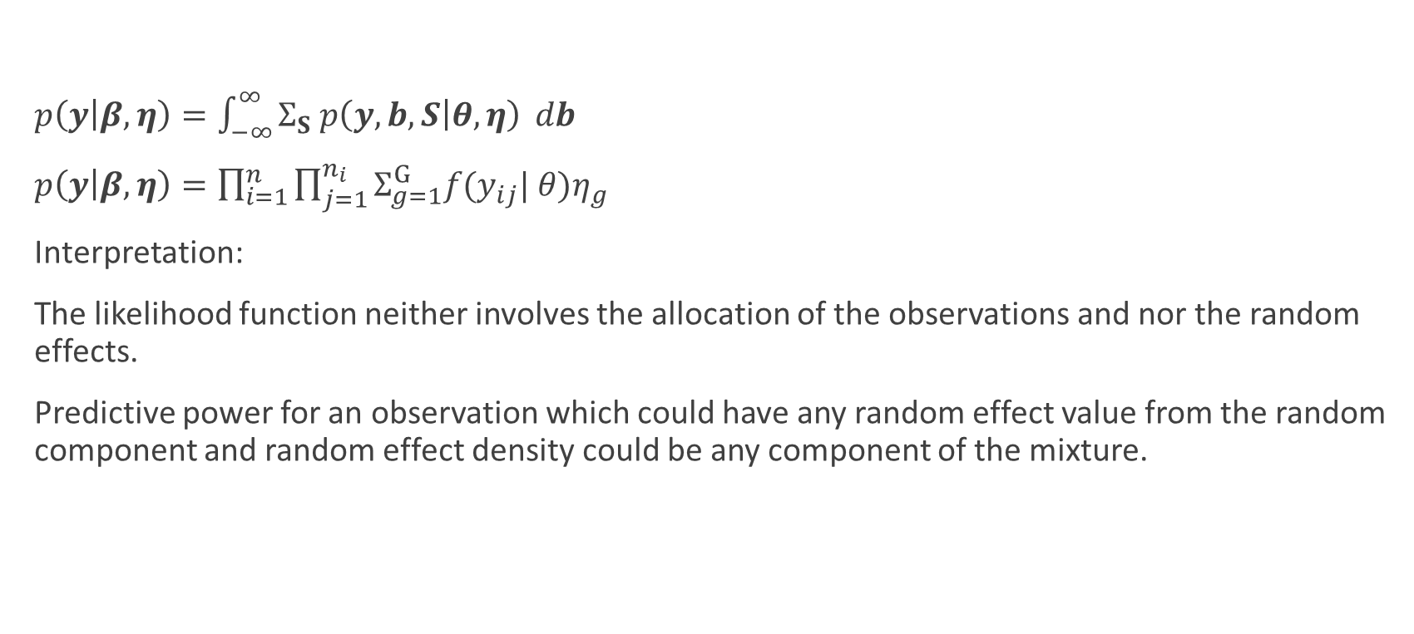
DIC based on observed data likelihood
$p\left(y | β, η\right)=\int_{−∞}^{∞}{Σ_{S} p\left(y,b,S | θ, η\right)} db$
$p\left(y | β, η\right)=\prod_{i=1}^{n}{\prod_{j=1}^{n_{i}}{Σ_{g=1}^{G}f(y_{ij}| θ)η_{g}}}$
Interpretation:
The likelihood function neither involves the allocation of the observations and nor the random effects.
Predictive power for an observation which could have any random effect value from the random component and random effect density could be any component of the mixture.

Slide 9
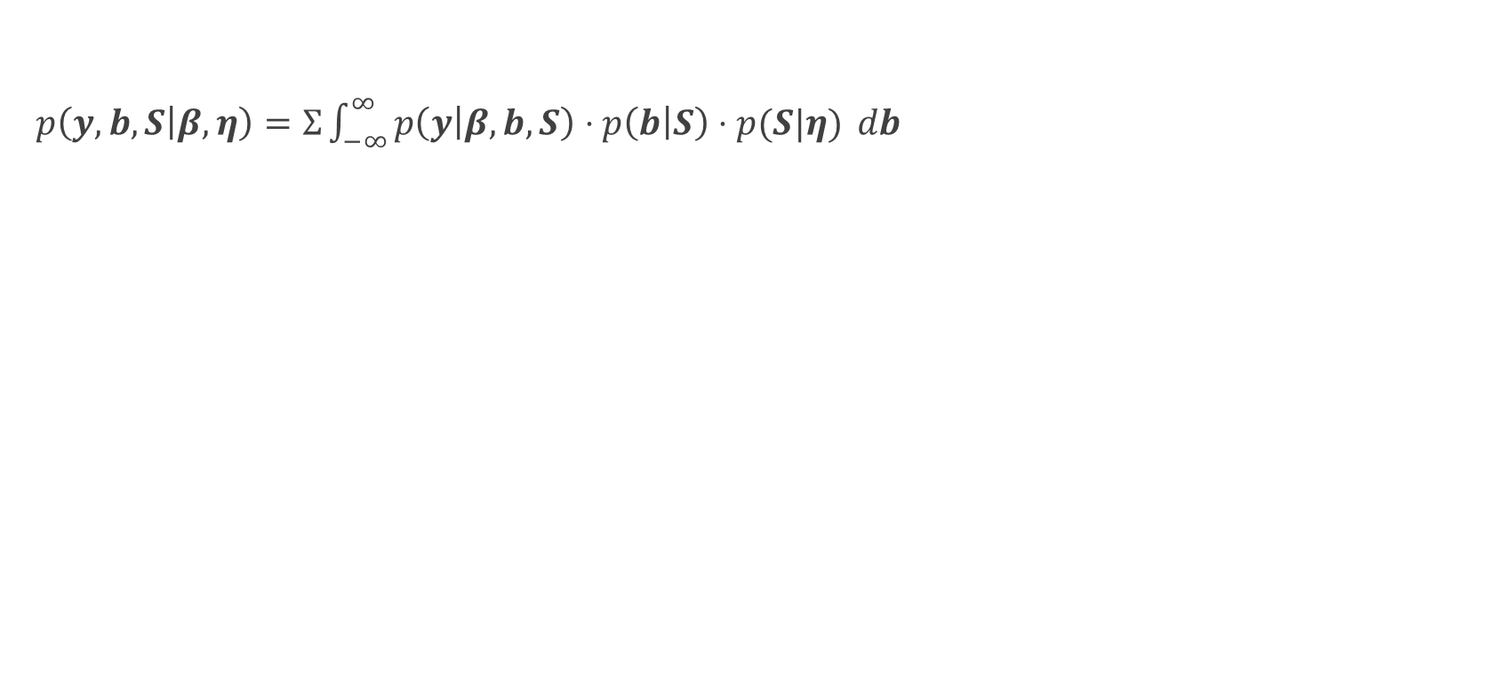
DIC based on complete data likelihood
$p\left(y,b,S | β, η\right)=Σ\int_{−∞}^{∞}{p\left(y | β, b, S\right)⋅p\left(b | S\right)⋅p(S|η)} db$

Slide 10
Results for 3 well separated components
Fitted Components | DIC 1 | DIC 2 | DIC 4 | DIC 5 | DIC 7
1 | 10531.02 (pD = 15.39) | 10528.17 (pD = 12.53) | 25837.71 (pD = 26.65) | 25966.21 (pD = 155.15) | 9213.49 (pD = 112.43)
2 | 10622.86 (pD = 8.59) | 10642.80 (pD = 28.52) | 26228.60 (pD = 42.98) | 26636.60 (pD = 450.99) | 9166.69 (pD = 76.05)
3 (good fit visually checked) | 13938.77 (pD = 4.41) | 13966.63 (pD = 32.27) | 22875.79 (pD = 63.78) | 23118.10 (pD = 306.08) | 9247.58 (pD = 157.10)
4 | 12364.91 (pD = 8.12) | 12387.15 (pD = 30.36) | 23767.86 (pD = 84.17) | 23965.74 (pD = 282.05) | 9250.44 (pD = 160.53)
5 | 14371.40 (pD = 149.29) | 14256.81 (pD = 34.71) | 23542.39 (pD = 87.64) | 22971.57 (pD = -483.18) | 9258.069 (pD = 166.94)
6 | 14521.31 (pD = 241.9265) | 14081.84 (pD = -197.55) | 23761.01 (pD = 99.70) | 21755.54 (pD = -1905.77) | 9255.67 (pD = 165.18)

Slide 11
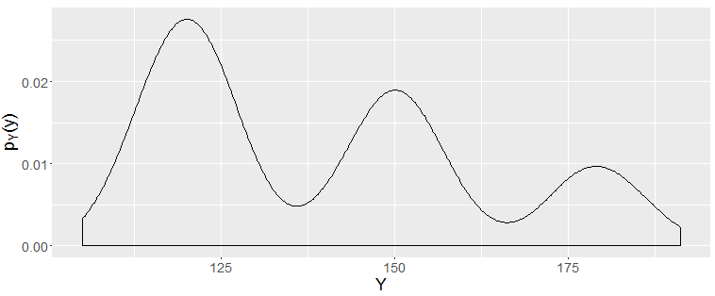
Well separated but unequal proportions

Slide 12
Results for 3 well separated components, un
Fitted Components | DIC 1 | DIC 2 | DIC 4 | DIC 5 | DIC 7
1 | 7028.43 (pD = 11.87) | 7035.24 (pD = 18.68) | 17040.36 (pD = 25.78) | 17076.01 (pD = 61.43) | 6110.43 (pD = 21.68)
2 | 7101.44 (pD = 14.22) | 7101.873 (pD = 14.66) | 17270.44 (pD = 44.16) | 17433.49 (pD = 207.21) | 6061.03 (pD = -21.71)
3 (good fit visually checked) | 7750.93 (pD = 9.28) | 7770.39 (pD = 28.73) | 15382.12 (pD = 64.10) | 15586.91 (pD = 268.89) | 6189.61 (pD = 106.94)
4 | 7783.76 (pD = 7.63) | 7854.453 (pD = 78.32) | 15658.16 (pD = 77.92) | 16037.37 (pD = 457.14) | 6189.28 (pD = 105.68)
5 | 7624.78 (pD = -162.35) | 7816.59 (pD = 29.45) | 15880.63 (pD = 85.80) | 12865.95 (pD = -2928.87) | 6191.27 (pD = 108.37)

Slide 13
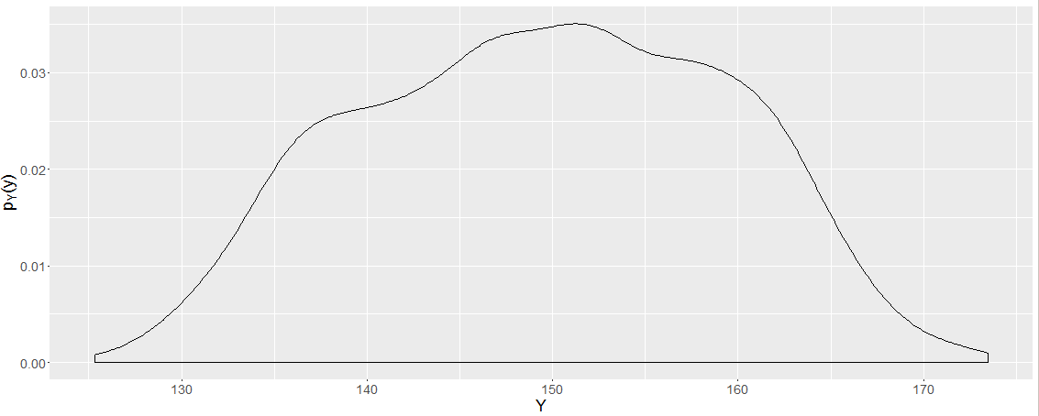
Partially fused components

Slide 14
Results for 3 partially fused components
Fitted Components | DIC 1 | DIC 2 | DIC 4 | DIC 5 | DIC 7
1 | 11652.52 (pD = 16.86) | 11631.82 (pD = -3.85) | 22250.66 (pD = 25.57) | 22449.76 (pD = 224.67) | 9252.85 (pD = 165.91)
2 (good fit visually checked) | 13050.51 (pD = -0.66) | 13045.97 (pD = -5.20) | 23105.93 (pD = 42.46) | 23751.53 (pD = 688.06) | 9235.00 (pD = 157.26)
3 | 15383.37 (pD = -99.51) | 14436.66 (pD = -1046.22) | 23209.09 (pD = 62.97) | 24137.68 (pD = 991.56) | 9238.93 (pD = 161.37)
4 | 15701.01 (pD = 77.61) | 14779.17 (pD = -844.23) | 23517.28 (pD = 75.05) | 22195.75 (pD = -1246.48) | 9230.14 (pD = 153.80)
5 | 16149.49 (pD = 295.3527) | 15155.12 (pD = -699.01) | 23812.6 (pD = 87.08) | 22494.82 (pD = -1230.70) | 9237.79 (pD = 159.73)
6 | 16806.97 (pD = 964.85) | 15324.64 (pD = -517.49) | 24151.71 (pD = 99.13) | 22906.95 (pD = -1145.64) | 9238.55 (pD = 162.99)

Slide 15
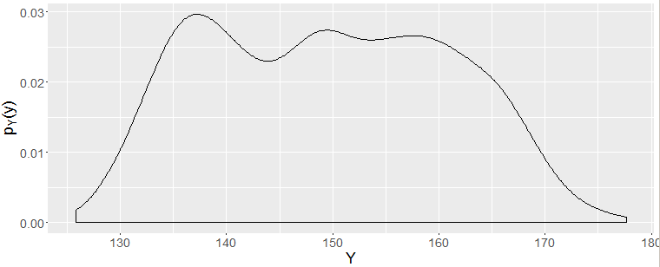
Partially fused components

Slide 16
Results for 3 partially fused components
Fitted Components | DIC 1 | DIC 2 | DIC 4 | DIC 5 | DIC 7
1 | 7478.89 (pD = 13.23) | 7476.65 (pD = 10.99) | 15304.93 (pD = 26.31) | 15428.91 (pD = 150.29) | 6183.127 (pD = 99.80)
2 | 8300.28 (pD = 6.79) | 8383.95 (pD = 90.47) | 15582.35 (pD = 43.18) | 15931.90 (pD = 392.74) | 6181.79 (pD = 104.65)
3 | 9284.91 (pD = -245.00) | 9046.34 (pD = -483.57) | 15528.08 (pD = 62.31) | 15995.44 (pD = 529.68) | 6185.74 (pD = 108.12)
4 | 10047.85 (pD = 182.57) | 9762.34 (pD = -102.94) | 15670.82 (pD = 76.11) | 13523.96 (pD = -2070.75) | 6186.42 (pD = 109.33)

Slide 17
Discussion
DIC 4 works best when components are well separated
pD in DIC1 gives an indication when components are well separated?
Some simulations are incorrect as JAGS does not throw away burn in part
HW test passed
Interpretation of the DIC

Slide 18
Posterior predictive checks
The various summary measures I tried (based on Frühwirth-Schnatter, 2006): mean, variance, skewness, kurtosis and even higher order moments of the observed data
In higher dimensions: Mardia’s skewness and kurtosis and a few more test statistics
In one dimension the posterior of component means can be checked
More detailed questions: Are the mixture proportions correctly identified?
Why some of the posterior checks aren’t working? Perhaps checking for model fit is not a good approach because with more components it is never bad.

Slide 19
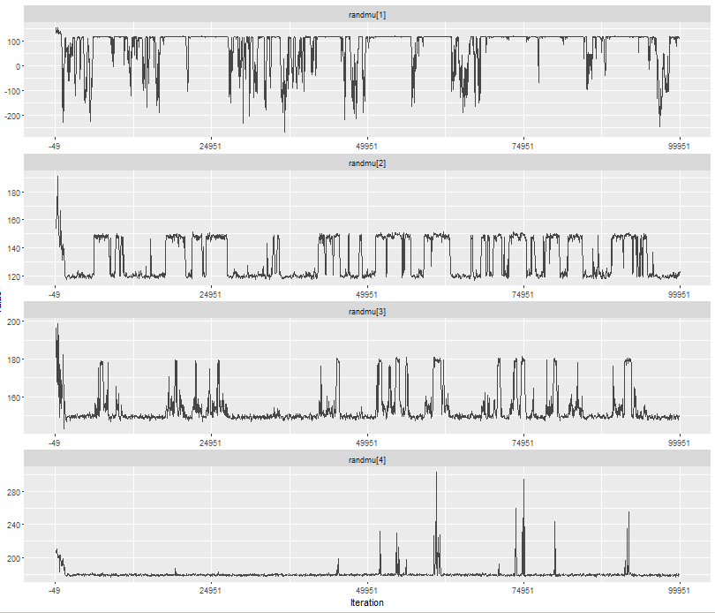
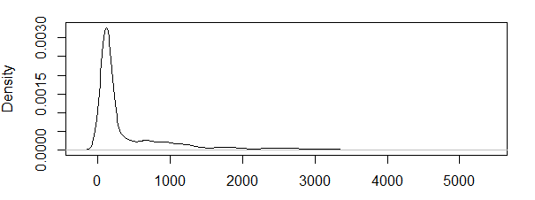
Mahalanobis distance of observed data to components

Slide 20
Bayes Factor
(4) -5098.472, -5098.497, -5097.623
(3) -5095.336, -5095.249, -5095.252
(2) -5201.313, -5201.166, -5199.257
(5) -5101.913, -5092.528, -5102.904
(6) -5105.789, -5104.56

Slide 21
What remains?
More simulations/Confirmatory simulations.
Modelling the blood donor data. I doubt I will be able to run so many observations on my computer.
Answer why things work, when I don’t expect them to? Or why they don’t when I expect them to work?

Slide 22
Feedback and questions from the panel

